Slide 1
Project 2 Help
CSCE351: OS kernel

Slide 2
Project 2: Think about this
Your thread is running along
Execute interrupt handler
Alarm come when PC = x
Return to interrupted thread
Your thread continues on

Slide 3
Project 2: Think about this
Your thread is running along
Execute interrupt handler
Alarm come when PC = x
Pick a new thread
New thread runs

Slide 4
Project 2: What you need
A few things you need to know
Where is the return address? (when a function exits, it needs to return to the caller)
What happens after exception handler exits?
Look at Alt_exception_entry.S
SP

Slide 5
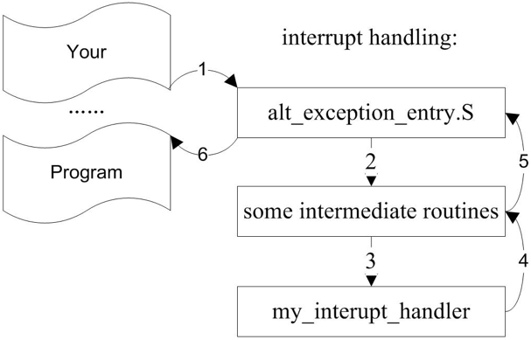
Project 2: Exception Handling

Slide 6
Project 2: Exception Handling
stw ra, 0(sp)
stw r1, 8(sp)
stw r2, 12(sp)
stw r3, 16(sp)
stw r4, 20(sp)
stw r5, 24(sp)
stw r6, 28(sp)
stw r7, 32(sp)
rdctl r5, estatus
stw r8, 36(sp)
stw r9, 40(sp)
stw r10, 44(sp)
stw r11, 48(sp)
stw r12, 52(sp)
stw r13, 56(sp)
stw r14, 60(sp)
stw r15, 64(sp)
stw r5, 68(sp)
addi r15, ea, -4
stw r15, 72(sp)
Step 1: what do you think it does?

Slide 7
Project 2: Exception Handling
ldw r5, 68(sp)
ldw ea, 72(sp) ldw ra, 0(sp)
wrctl estatus, r5
ldw r1, 8(sp)
ldw r2, 12(sp)
ldw r3, 16(sp)
ldw r4, 20(sp)
ldw r5, 24(sp)
ldw r6, 28(sp)
ldw r7, 32(sp)
ldw r8, 36(sp)
ldw r9, 40(sp)
ldw r10, 44(sp)
ldw r11, 48(sp)
ldw r12, 52(sp)
ldw r13, 56(sp)
ldw r14, 60(sp)
ldw r15, 64(sp)
Step 5: what do you think it does?

Slide 8
Project 2: What you need
void * myscheduler( void *context)
{ …
return newcontext;
}
SP
Where do you see a function argument (e.g., context)?
Where do you find return value (e.g., newcontext)?

